Slide 1

Accelewhen?
Under which circumstances is
Acceleread Accelewrite an
effective intervention?
Emma Herring
Notes:
Research the intervention ARAW
It is in What Works for Children and Young People with Literacy Difficulties by Brooks (2013) as a recommended mainstream intervention
So I’ve been thinking about which groups of children would it be most effective for.

Slide 2
Outline
Acceleread Accelewrite intervention
Underlying principles
Evidence Base
Implications
Notes:
I will describe intervention – the manual talks about the number of underlying principles which makes it effective so I’ll talk about these.
Biggest section as there are only 4 studies into its effectiveness, will look at these
Then finish with implications and conclusions

Slide 3
Acceleread Accelewrite intervention
Notes:
Acceleread Accelewrite (ARAW) is a reading and writing intervention.
It says it uses motivational aspects of technology, and creates a structured learning system where pupils receive immediate feedback.
Talking computer project carried out in 1992, by Martin Miles and Vivienne Clifford.
Over 2 years, system revised and Acceleread Accelewrite published in 1994. 21 years ago.
Intervention is still being updated, latest manual copyrighted in 2014 and specifically talks about software for tablets, e.g. iPads.
The intervention provides schools with a pack of cards, each displaying four sentences, and recommendations of text-to-speech conversion software to download. The child works with an adult to read and memorise a sentence, they then type the sentence into the computer, and the software reads back each word after it has been typed and the entire sentence when the full stop is entered. If the child has spelled the word incorrectly, they are encouraged to identify the mistake and re-type the word correctly. This is repeated until all sentences on the card have been typed. Learners use the intervention for 20 minutes each day for between four and eight weeks.
ARAW claims to develop visual and auditory memory, spelling, and reading (Clifford & Miles, 2014).
Different studies into the effectiveness of ARAW have used different outcome variables but one measure common to all research is reading,
Most empirical evidence for ARAW and reading.
Therefore this critique will specifically focus its effectiveness at improving the reading skills of learners.

Slide 4

Underlying Principles
Visual Verbal Associations
Grapheme Phoneme
Correspondence
Notes:
ARAW says that making links between letters and sounds is a major stumbling block for some children.
ARAW provides constant and immediate speech feedback on writing makes basic task of developing associations between letters and sounds less abstract, easier.
Phonemes: smallest units of sounds in spoken words
Graphemes: letter or group of letters which represent phonemes
When we learn to read, we have to learn how to map written graphemes onto spoken phonemes.
Research has found that the ability to map graphemes onto phonemes does seem to play unique roll in reading
Windfuhr and Snowling (2001) visual verbal PAL unique proportion of variation in word reading even when phonemic awareness controlled for
75 6-11year olds, 4 abstract shapes and nonsense words for them.
Hulme et al (2007) visual verbal PAL was unique predictor of word reading, other forms of PAL were not. Key associative learning process.
study 1: 66 Year3-6 children, abstract shapes and nonsense words
study 2: 127 Year 3-5 children, abstract shapes and nonsense words
Solity (2000) Early Reading Research project, environmental changes to how reading is taught can improve GPC
3xdaily sessions for 15minutes
By end of Year 1, only 2% of ERR children were low achievers, 65% comparison children
BUT
Treiman (2000) need phonological awareness, and letter knowledge before ready to map graphemes onto phonemes
Foulin (2005) letter name knowledge is long-term predictor of reading ability
Hulme and Snowling (2013) PA (and LSK) is a cognitive foundation for learning to read
Perhaps ARAW is appropriate after children have PA and LK
ARAW’s multi-sensory approach will help development of GPC
(Model of Working Memory says multidimensional information can be created by episodic buffer, perhaps by providing learners with visual words and auditory speech)
BUT
Minimal multi-sensory information, black text on white background
Other interventions use exciting graphics
ARAW uses entire sentences
Phonics teaching: detect individual sounds, map to graphemes, learn to decode through segmenting and blending
So children must already have skills of segmenting words into sounds, by recalling phonemes from graphemes
Learning Hierarchy: learn skills to acquisition, fluency, retention, generalisation, adaptation.
Not appropriate for children who struggle or who are just developing these skills.
Useful intervention for supporting development of skills to fluency level?
Could adapt ARAW
Ask children to type individual words to reinforce GPC as they are taught in classroom
Plus split-attention problem when rehearsing sentences whilst typing 1 word

Slide 5
Underlying Principles
Visual Verbal Associations
Grapheme Phoneme
Correspondence
Phonological awareness and
letter knowledge
Notes:
ARAW says that making links between letters and sounds is a major stumbling block for some children.
ARAW provides constant and immediate speech feedback on writing makes basic task of developing associations between letters and sounds less abstract, easier.
Phonemes: smallest units of sounds in spoken words
Graphemes: letter or group of letters which represent phonemes
When we learn to read, we have to learn how to map written graphemes onto spoken phonemes.
Research has found that the ability to map graphemes onto phonemes does seem to play unique roll in reading
Windfuhr and Snowling (2001) visual verbal PAL unique proportion of variation in word reading even when phonemic awareness controlled for
75 6-11year olds, 4 abstract shapes and nonsense words for them.
Hulme et al (2007) visual verbal PAL was unique predictor of word reading, other forms of PAL were not. Key associative learning process.
study 1: 66 Year3-6 children, abstract shapes and nonsense words
study 2: 127 Year 3-5 children, abstract shapes and nonsense words
Solity (2000) Early Reading Research project, environmental changes to how reading is taught can improve GPC
3xdaily sessions for 15minutes
By end of Year 1, only 2% of ERR children were low achievers, 65% comparison children
BUT
Treiman (2000) need phonological awareness, and letter knowledge before ready to map graphemes onto phonemes
Foulin (2005) letter name knowledge is long-term predictor of reading ability
Hulme and Snowling (2013) PA (and LSK) is a cognitive foundation for learning to read
Perhaps ARAW is appropriate after children have PA and LK
ARAW’s multi-sensory approach will help development of GPC
(Model of Working Memory says multidimensional information can be created by episodic buffer, perhaps by providing learners with visual words and auditory speech)
BUT
Minimal multi-sensory information, black text on white background
Other interventions use exciting graphics
ARAW uses entire sentences
Phonics teaching: detect individual sounds, map to graphemes, learn to decode through segmenting and blending
So children must already have skills of segmenting words into sounds, by recalling phonemes from graphemes
Learning Hierarchy: learn skills to acquisition, fluency, retention, generalisation, adaptation.
Not appropriate for children who struggle or who are just developing these skills.
Useful intervention for supporting development of skills to fluency level?
Could adapt ARAW
Ask children to type individual words to reinforce GPC as they are taught in classroom
Plus split-attention problem when rehearsing sentences whilst typing 1 word

Slide 6
Underlying Principles
Visual Verbal Associations
Grapheme Phoneme
Correspondence
Phonological awareness and
letter knowledge
Multi-sensory
Notes:
ARAW says that making links between letters and sounds is a major stumbling block for some children.
ARAW provides constant and immediate speech feedback on writing makes basic task of developing associations between letters and sounds less abstract, easier.
Phonemes: smallest units of sounds in spoken words
Graphemes: letter or group of letters which represent phonemes
When we learn to read, we have to learn how to map written graphemes onto spoken phonemes.
Research has found that the ability to map graphemes onto phonemes does seem to play unique roll in reading
Windfuhr and Snowling (2001) visual verbal PAL unique proportion of variation in word reading even when phonemic awareness controlled for
75 6-11year olds, 4 abstract shapes and nonsense words for them.
Hulme et al (2007) visual verbal PAL was unique predictor of word reading, other forms of PAL were not. Key associative learning process.
study 1: 66 Year3-6 children, abstract shapes and nonsense words
study 2: 127 Year 3-5 children, abstract shapes and nonsense words
Solity (2000) Early Reading Research project, environmental changes to how reading is taught can improve GPC
3xdaily sessions for 15minutes
By end of Year 1, only 2% of ERR children were low achievers, 65% comparison children
BUT
Treiman (2000) need phonological awareness, and letter knowledge before ready to map graphemes onto phonemes
Foulin (2005) letter name knowledge is long-term predictor of reading ability
Hulme and Snowling (2013) PA (and LSK) is a cognitive foundation for learning to read
Perhaps ARAW is appropriate after children have PA and LK
ARAW’s multi-sensory approach will help development of GPC
(Model of Working Memory says multidimensional information can be created by episodic buffer, perhaps by providing learners with visual words and auditory speech)
BUT
Minimal multi-sensory information, black text on white background
Other interventions use exciting graphics
ARAW uses entire sentences
Phonics teaching: detect individual sounds, map to graphemes, learn to decode through segmenting and blending
So children must already have skills of segmenting words into sounds, by recalling phonemes from graphemes
Learning Hierarchy: learn skills to acquisition, fluency, retention, generalisation, adaptation.
Not appropriate for children who struggle or who are just developing these skills.
Useful intervention for supporting development of skills to fluency level?
Could adapt ARAW
Ask children to type individual words to reinforce GPC as they are taught in classroom
Plus split-attention problem when rehearsing sentences whilst typing 1 word

Slide 7
Underlying Principles
Visual Verbal Associations
Grapheme Phoneme
Correspondence
Phonological awareness and
letter knowledge
Multi-sensory
Use of whole sentences
Notes:
ARAW says that making links between letters and sounds is a major stumbling block for some children.
ARAW provides constant and immediate speech feedback on writing makes basic task of developing associations between letters and sounds less abstract, easier.
Phonemes: smallest units of sounds in spoken words
Graphemes: letter or group of letters which represent phonemes
When we learn to read, we have to learn how to map written graphemes onto spoken phonemes.
Research has found that the ability to map graphemes onto phonemes does seem to play unique roll in reading
Windfuhr and Snowling (2001) visual verbal PAL unique proportion of variation in word reading even when phonemic awareness controlled for
75 6-11year olds, 4 abstract shapes and nonsense words for them.
Hulme et al (2007) visual verbal PAL was unique predictor of word reading, other forms of PAL were not. Key associative learning process.
study 1: 66 Year3-6 children, abstract shapes and nonsense words
study 2: 127 Year 3-5 children, abstract shapes and nonsense words
Solity (2000) Early Reading Research project, environmental changes to how reading is taught can improve GPC
3xdaily sessions for 15minutes
By end of Year 1, only 2% of ERR children were low achievers, 65% comparison children
BUT
Treiman (2000) need phonological awareness, and letter knowledge before ready to map graphemes onto phonemes
Foulin (2005) letter name knowledge is long-term predictor of reading ability
Hulme and Snowling (2013) PA (and LSK) is a cognitive foundation for learning to read
Perhaps ARAW is appropriate after children have PA and LK
ARAW’s multi-sensory approach will help development of GPC
(Model of Working Memory says multidimensional information can be created by episodic buffer, perhaps by providing learners with visual words and auditory speech)
BUT
Minimal multi-sensory information, black text on white background
Other interventions use exciting graphics
ARAW uses entire sentences
Phonics teaching: detect individual sounds, map to graphemes, learn to decode through segmenting and blending
So children must already have skills of segmenting words into sounds, by recalling phonemes from graphemes
Learning Hierarchy: learn skills to acquisition, fluency, retention, generalisation, adaptation.
Not appropriate for children who struggle or who are just developing these skills.
Useful intervention for supporting development of skills to fluency level?
Could adapt ARAW
Ask children to type individual words to reinforce GPC as they are taught in classroom
Plus split-attention problem when rehearsing sentences whilst typing 1 word

Slide 8
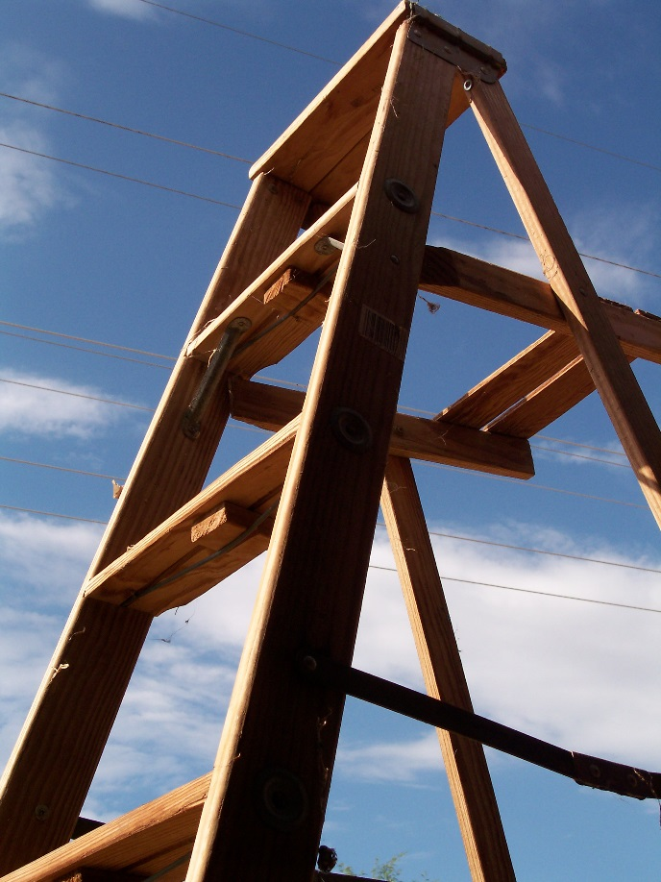
Underlying Principles
Structure of Input
Notes:
GPC introduced in structure reflecting phonics phase list from National Literacy Strategy (2003)
Solity and Vousden (2009)
reading scheme books vs real books
large proportion of English language is highly regular
90% of text could be read by children by learning 64 high frequency GPC and 89 key sight words
Additional learning of sight words or GPC of limited value (Shapiro and Solity, 2008)
No reason why couldn’t use principle (type word, receive speech feedback) but organise own input structure

Slide 9

Underlying Principles
Feedback
Notes:
Unique feature of ARAW is that it provides consistent feedback
After a word written – computer reads it back to you.
This could be provided by an adult,
Intervention is supported on 1:1 basis
so what is unique about computer-based feedback?
Shute (2008) feedback from a trustworthy source is taken more seriously, potential human biases are perceived as being eliminated in computer-based feedback
Hattie and Timperley (2007) model of feedback: task, process, self-regulation, and self.
task: how well a task is being performed
process: about the processes underlying a task, includes error detection
self-regulation: regulate actions to meet learning goals
self: feedback about the self as a person, clever boy!
Humans too often provide feedback at self level.
Computer provides task feedback ☺
But means you miss out on process and self-regulation feedback.

Slide 10

Underlying Principles
Support at the Right Level
Manipulate the materials
Notes:
Support should be provided as much as necessary and as little as possible
Adult should manipulate materials so learner progresses at correct pace for them
Mediated learning approach pioneered by Feuerstein, adults place themselves between stimuli and learners, modifying the stimuli so the learner experiences success
Allow the learner to feel competent
Self-determination theory
But this relies on skills of TA
Blatchford et al (2009) negative relationship between amount of TA support received and pupil progress
Deployment and impact of support staff project, surveys
Rubie-Davies et al (2010) TAs may stifle pupil independence, focused on task completing not pupil understanding
Part of DISS project
audio recordings of adult-to-pupil interactions
Other computer based reading interventions take out this variable by having computer make moment-to-moment adaptations rather than relying on adult

Slide 11
Underlying Principles
Support at the Right Level
Manipulate the materials
Reliant on skills of adult
Notes:
Support should be provided as much as necessary and as little as possible
Adult should manipulate materials so learner progresses at correct pace for them
Mediated learning approach pioneered by Feuerstein, adults place themselves between stimuli and learners, modifying the stimuli so the learner experiences success
Allow the learner to feel competent
Self-determination theory
But this relies on skills of TA
Blatchford et al (2009) negative relationship between amount of TA support received and pupil progress
Deployment and impact of support staff project, surveys
Rubie-Davies et al (2010) TAs may stifle pupil independence, focused on task completing not pupil understanding
Part of DISS project
audio recordings of adult-to-pupil interactions
Other computer based reading interventions take out this variable by having computer make moment-to-moment adaptations rather than relying on adult

Slide 12

Underlying Principles
Making Mistakes
Notes:
ARAW will help pupils learn that dealing successfully with errors is a central part of learning.
Pupils should be helped to see mistakes as opportunities to reflect on and modify their actions to achieve success.
They don’t need to be protected from mistakes!
Dweck (2006) mindsets
Fixed M: intelligence fixed, avoid situations in which you may fail
Growth M: intelligence changeable, see mistakes as helping them learn
Potts and Shanks (2014)
Inserting tests into learning process, even when novel material taught, facilitated retention
But with answer generation not selection

Slide 13
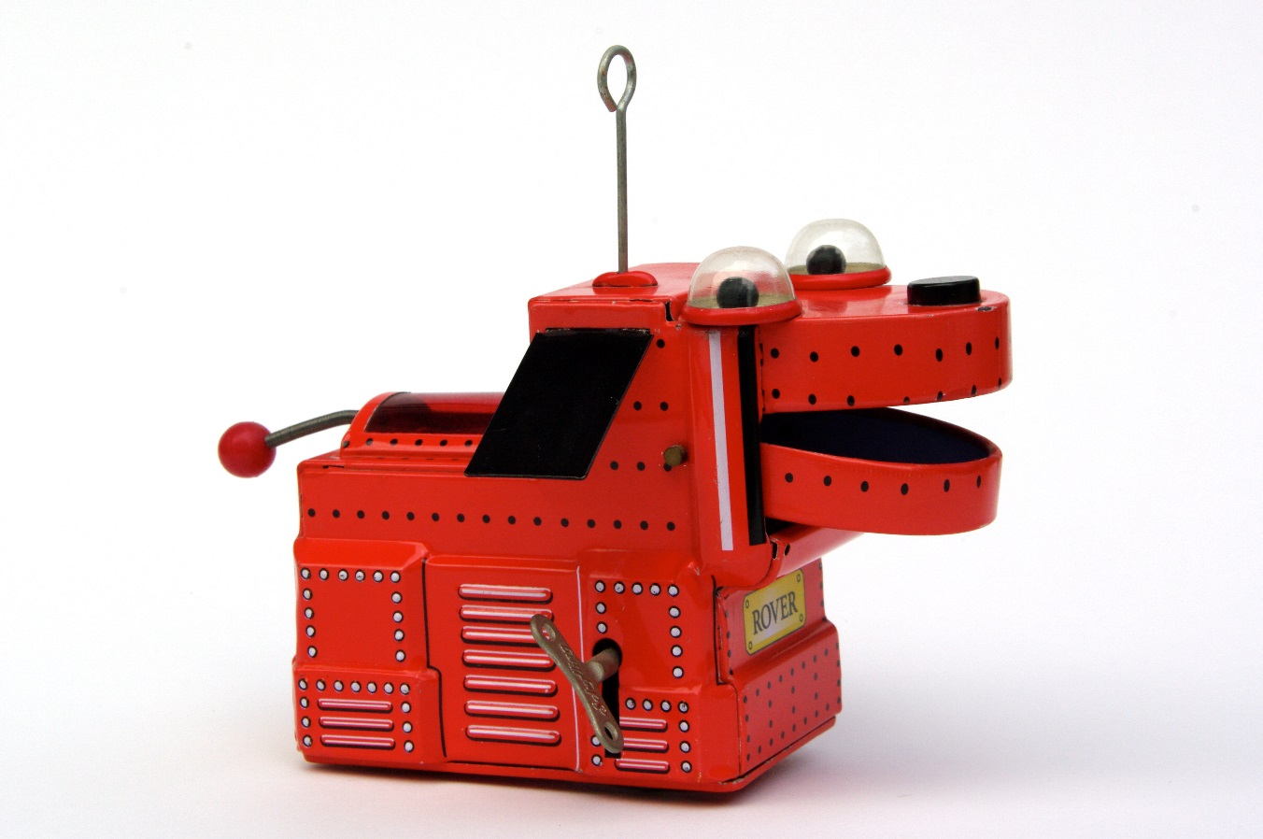
Underlying Principles
Technology
Notes:
The vast majority of children find technology enormously motivating
ARAW has the power to engage reluctant learners who have failed consistently
Some studies have shown that CAI can have high pupil engagement
Bryant et al (2014)
Higher engagement in CAI
Higher word identification and reading fluency in teacher direct instruction
4 Ps with learning difficulties
Used ipads
Macaruso et al (2006)
CAI well-suited for providing supplementary instruction because of lively graphics, feedback, positive reinforcement, and students work at own pace.
ARAW does not have own software
NO lively graphics

Slide 14
Evidence Base
Author and Year | Participants | Measures | Results
Jersey Advisory Service 1993 | 61 Year 3 to 9 | BAS reading accuracy | Effect size 0.55
Miles 2002 unpublished | 30 Years 5 and 6 | BAS word reading and spelling | RG 16.1 RG 9.8
Couzens 2005-6 unpublished | 149 Years 3 to 6 | NFER reading comp and spelling | RG 7.7 RG 6.2
Nugent 2010 | 9 Aged 6 to 17 | Word reading, sentence reading, spelling | Means of 6.6 7.3 4.3
Notes:
In what works for children with literacy difficulties, Brooks (2013) recommended ARAW as a mainstream intervention based on the results of three studies.
Jersey, 1993
61 young people in school years three to nine, in 15 primary and four secondary schools, who were described has having low reading attainment. The pupils completed ARAW over four weeks, and had showed improvements in reading accuracy as measured by the British Ability Scales (BAS); improvements were also maintained when measured 10 weeks and six months later. Pre-tests scores were actually only half a standard deviation below the national norm, despite pupils described as well-below average, but after the intervention scores were within national norms. The reported effect size was 0.55.
Miles (2002)
30 pupils in years five and six, with reading or spelling difficulties, completed ARAW for four weeks. The pupil’s reading accuracy and spelling was measured using the BAS. Pre- and post-test data were not recorded, but ratio gains showed remarkable progress of 16.1 for reading accuracy and 9.8 for spelling. Ratio gains represent the amount of progress made divided by the time spent on the intervention (Topping & Lindsay, 1992).
Couzens (2005-6)
149 low attaining children in years three to six (Brooks, 2013). Participants completed ARAW over four weeks, and reading comprehension and spelling were measured using the NFER tests. Again, pre-and post-test data were not recorded but ratio gains showed remarkable progress of 7.7 for reading comprehension and 6.2 for spelling.
National Foundation for Educational Research Read
Nugent (2010)
The author recruited 24 traveller children aged between six and 17 years old, and worked with their 11 teachers across 10 schools. Three different reading interventions were evaluated in the study, so just nine participants used ARAW. Word reading, sentence reading, and spelling were measured using the WRAT4 Test; results showed that participants made a standard score mean gain of 6.6 in word reading, 7.3 in sentence reading, and 4.3 in spelling. To calculate the ratio gains and effect sizes, data from all 24 students completing different interventions were combined, and so it is not possible to conclude the unique effects of ARAW.
It is difficult to conclude the effectiveness of ARAW from the above studies. The calculated ratio gains from the first three data sets have resulted in the intervention being recommended by Brooks (2013) but the studies have methodological design flaws.
None of the three studies use control groups in order to compare ARAW to other reading interventions or teaching-as-usual, so it is difficult to conclude whether ARAW provides learning benefits above that of other interventions schools may also have access to. The use of a between-groups design would allow calculation of statistical significance.
Two of the three studies did not collect pre-and post-data meaning that effect sizes could not be calculated, and none of the data was published in peer reviewed journals.
The study published by Nugent (2010) involved a small number of participants completing ARAW, and because it was questioning if interventions in general could promote learning in traveller children, it analysed results by pooling data for all three interventions rather than specifically examining the effects of each one.

Slide 15

Implications
Research
Notes:
Control Groups
Compare ARAW to other interventions schools have access to
Also use group which just has additional time on reading activities to make sure not just a time factor
Pre and Post Data reported

Slide 16

Implications
Useful under these conditions…
Notes:
Role for EPs, helping staff to identify children who it may be effective for
May be effective feedback for children who have PA and LK but are struggling to map graphemes onto phonemes
Also train staff so
Staff should understand that:
they need to mediate learning so children progress through work at correct level of challenge,
making mistakes is core to the programme,
they can help children reflect on strategies that helped them succeed

Slide 17

Implications
Adapting Acceleread Accelewrite
Notes:
EPs can also help schools feel confident to adapt the programme
Create more sentences if children need additional practice of particular phoneme-grapheme pairing
Use for words not sentences
Change sentences so appropriate for older learners/engage interest

Slide 18

Implications
Reading is more than cognitive skills
Notes:
Reading is more than cognitive skills
Chapman and Tunmer (2003)
Reading programmes should include strategies to ameliorate negative self-perceptions as well as teaching fundamental skills
Morgan and Fuchs (2007)
Reading achievement and motivation may predict each other over time, more research needed
15 studies reviewed
Atkinson (2006)
Interviewed pupils – greater access to a range of resources was key to enjoyment of reading at school

Slide 19
Conclusions
Be clear what skills you are trying to target
Adapt where necessary
Don’t forget that reading is more than cognitive skills
More research is needed
Notes:
May support learning of GPC to fluency once children have developed skills of PA, LK, and decoding
Adapt – use it flexibly to support students
Emotional side of reading
Research is needed as weak evidence base

Slide 20

http://www.everystockphoto.com/photo.php?imageId=8982185&searchId=59b40a4df998529eb7264171ced09202&npos=37
Notes:
Thank you for listening.
Any questions?

